Slide 1
2025 Open Enrollment Options
OCU Board
October 4, 2024
Internal Use Only

Slide 2
Presentation Slides
Open Enrollment Overview
What’s New for 2025
2025 Plan Design and Contributions
Communication Overview
Open Enrollment Video

Slide 3
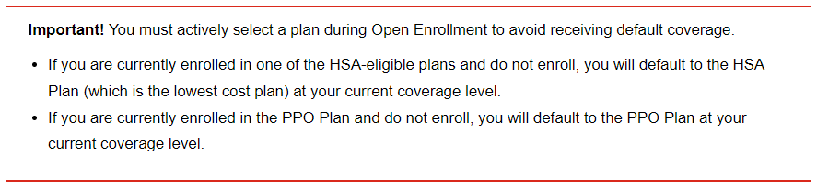
Open Enrollment Overview
Open Enrollment Dates:
October 25th through November 8th!
Make selections through the Cummins Health Benefit Center or contact the Cummins Health Benefits Service Center at 1-877-377-4357

Slide 4
Open Enrollment Overview
Learn more about your choices!
Medical ― Covers medical services and prescriptions and includes access to vision coverage and resources to help you get the care you need. You have several options available, including the PPO Plan, and two updated HSA-compatible plans ― the HSA Plan and HSA Plus Plan. This year, your employee contributions will be in line with your pay.
Dental ― Covers a broad range of dental services, including preventive care, basic services, major services and orthodontia. New this year, you can choose to use Cummins’ Limited Purpose Health Care FSA to help pay for eligible dental expenses.
Supplemental medical benefits – Provides optional coverage you can elect to ensure additional protection in case of specific medical events like an accident, hospital stay or diagnosis of a critical illness.
Health Savings Account (HSA) ― Offers an opportunity to save tax-free for your qualified health care expenses if you enroll in the HSA Plan or HSA Plus Plan. Think of your HSA as a “savings account.” You can use the money in your account to help pay for care now or grow your account for your future health care needs.
Flexible Spending Accounts (FSAs) including the new Limited Purpose Health Care FSA* ― Provides opportunities to save on taxes by paying yourself back for eligible health care and/or dependent care expenses with tax-free dollars, including the new Limited Purpose Health Care FSA that you can use to pay for eligible dental and vision expenses, *if you are enrolled in an HSA Plan. Due to IRS requirements, you will lose any amounts you contribute but don’t use during the year.
Optional life and AD&D Insurance ― Optional life and AD&D insurance offers financial benefits in case of serious injury or death and are in addition to your employer-provided coverage. Optional coverage is also available for spouses/domestic partners and dependent children.

Slide 5
Open Enrollment Overview
Choosing your medical plan
Features important to you — Think about your preferences and what each plan has to offer. For example, are you interested in saving for future health care expenses tax free?
Your coverage needs — Consider how much medical care you typically use each year. Do you mostly just get preventive care (like annual physicals and screenings) or do you typically find yourself in the doctor’s office quite a few times a year, seeing specialists and/or managing a condition?
Your costs and budget — Don’t just focus on the employee contributions. Factor in all your costs, including what you might pay as you receive care throughout the year. Also consider how you prefer to pay (more upfront through higher employee contributions or more as you go if you need care) — and remember to think through the potential of an unexpected health care expense.
If you prefer lower contributions with higher out-of-pocket costs, consider the HSA Plan (HSA 5000).
If you prefer a mid-range option for contributions and out-of-pocket costs, the HSA Plus Plan (HSA 2250) may be right for you. And, with the HSA Plus Plan, Cummins will contribute into your HSA to help boost your savings.
If you’d rather pay higher employee contributions and lower out-of-pocket costs at time of service, look into the PPO Plan to see if it’s the best fit for you.
If you’re not sure which plan to choose, check out the online decision support tool available during enrollment. This year’s enhanced plan uses your data to give you personalized recommendations and insights into what health plan could best fit your needs.

Slide 6
What’s New for 2025
Updated Medical Plan Choices and Medical Premium Contribution Based on Pay
2025 brings an updated lineup of medical plans. You’ll continue to have three plans to consider: The PPO Plan, HSA Plan and HSA Plus Plan.
With two redesigned Health Savings Account (HSA) Plans, the HSA Plan and HSA Plus Plan, there is now a larger range between plan deductibles (the amount you pay before coverage kicks in) and the limits on your out-of-pocket maximums will no longer vary based on your annual pay.
The HSA Plus Plan is the only option that includes a Cummins contribution to your HSA to help boost your savings.
Medical employee contributions based on annual pay
Your 2025 employee contributions will depend on your annual pay. This makes what you pay for medical more in line with your income. It is a more equitable and fair approach because it considers the different financial circumstances faced by employees at various pay levels.
What this means for you
Your specific employee contributions will depend on your pay (if you make less, you’ll pay less), the plan you choose and who you cover. With the redesigned medical plans providing more flexibility to choose what best fits your budget, many could see a decrease compared to what they pay today depending on their coverage choices.

Slide 7
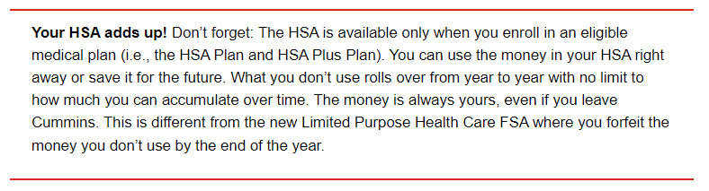
What’s New for 2025
NEW Limited Purpose Health Care FSA
This year, Cummins is offering the new Limited Purpose Health Care FSA that’s available if you enroll in the HSA Plan or HSA Plus Plan medical coverage.
Meet your tax-savings match: HSA and Limited Purpose Health Care FSA
Pairing your HSA with contributions to the Limited Purpose Health Care FSA is another way to make the most of your money and maximize your tax-free savings. Quick tips to keep in mind:
Use the Limited Purpose Health Care FSA to pay tax-free for eligible dental and vision expenses.
  Estimate your expected expenses for 2025 when you enroll.
  Plan carefully as this account has a “use it or lose it” rule. You will forfeit any unused funds at the end of the plan year.
  Your contributions don’t count towards HSA contribution limits for the year.
Focus your HSA on other health care needs now and in the future.
  Keep more of your money in your HSA where it can grow tax-free for future health expenses by using the Limited Purpose Health Care FSA to cover more immediate dental and vision expenses.

Slide 8
What’s New for 2025
More tax savings with increased HSA contribution limits
For 2025, you’ll be able to contribute more to your HSA if you enroll in the HSA or HSA Plus Plan and meet all eligibility requirements. IRS limits will increase to:
  $4,300 if you enroll in individual coverage
  $8,550 if you enroll in family coverage
Plus, you can contribute an additional $1,000 “catch-up” contribution if you’ll be age 55 or older in 2025.
How the HSA and medical coverage make a great pair
  Essential coverage with tax savings. Your Cummins medical plan works hand in hand with an HSA to provide coverage for the care you need and opportunities to save on taxes. An HSA can be funded by you and/or Cummins, depending on your medical plan enrollment, and you can save and spend your money without ever paying a dime in taxes (as long as you use your dollars for qualified expenses).
  Makes you money. Put your money to work for you in your HSA with the potential to earn tax-free interest and investment returns. It’s a great way to grow your dollars to help cover your qualified health care expenses.
  Builds over time. Your HSA money rolls over from year to year, building up over time to use for your future health care needs. It’s your account and yours to keep after you retire or if you leave Cummins.
Remember, the HSA is available only if you enroll in one of the qualified medical plans — the HSA Plan or HSA Plus Plan.
Please see Compare Savings Account Document to see what works best for you, HSA, Limited FSA, or Health Care FSA!!

Slide 9
What’s New for 2025 - Continued
Enhanced Diabetes Management Program
Access to information, skills and resources to help manage Prediabetes, Type 1 and Type 2.
Virta Type 2 Diabetes Reversal Program that aims to help individuals manage and possibly reverse their diabetes
New Medical Second Opinion Administrator
Anthem VSO will be the new provider for the medical second opinion program
.
New resource for enrollment to help simply your medical plan selection
Consider your health care needs for next year and take advantage of the new personalized decision-support tool to help you choose your plan.
If you’re not sure which plan to choose, check out the online decision support tool available during enrollment. This year’s enhanced plan uses your data to give you personalized recommendations and insights into what health plan could best fit your needs.

Slide 10
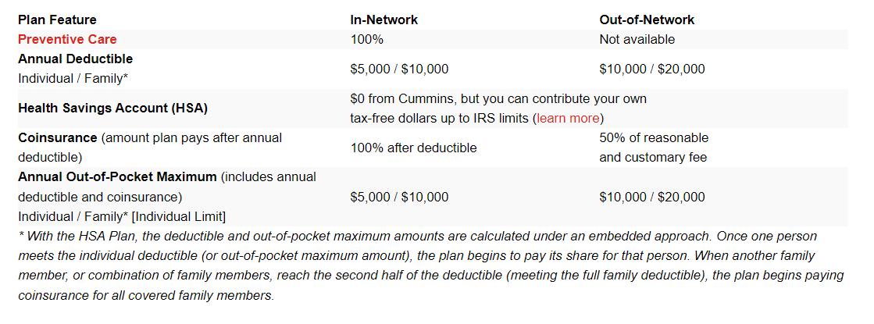
2025 HSA Plan (HSA 5000)

Slide 11
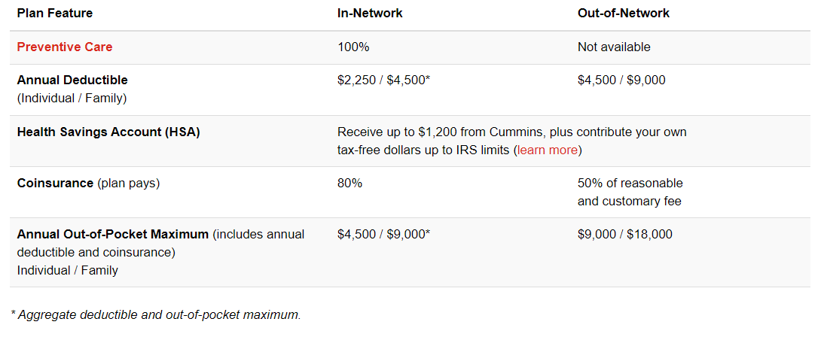
2025 HSA Plus Plan (HSA 2250)
If you elect the HSA Plus Plan, Cummins will contribute $600 for Employee only coverage and $1,200 for all other coverage levels. If you are not eligible to contribute to an HSA, Cummins will contribute to a Health Reimbursement Arrangement (HRA) instead.

Slide 12
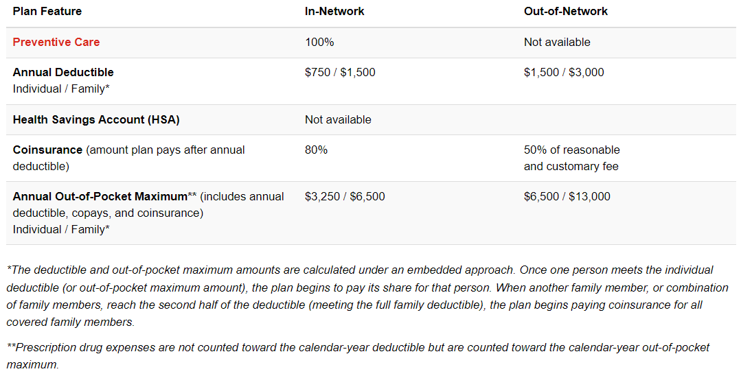
2025 PPO Plan

Slide 13
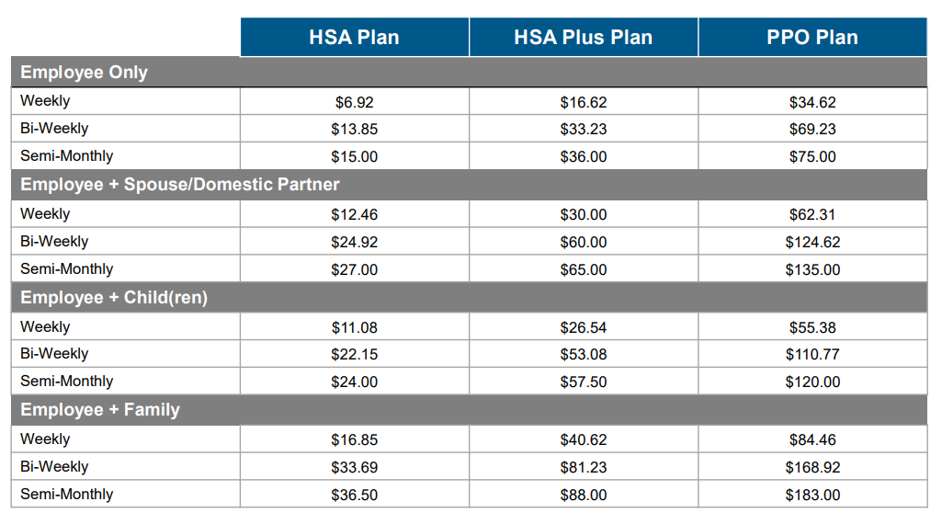
Employee Contributions for Medical
For employees whose base pay* is less than $60,000 a year
* Includes only base salary or hourly pay; does not include variable compensation, such as bonuses or overtime pay

Slide 14
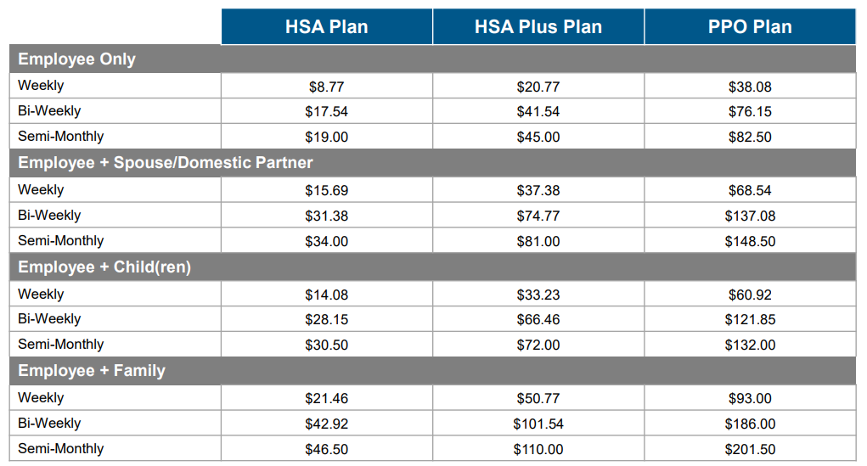
Employee Contributions for Medical
For employees whose base pay* is between $60,001-$100,000 a year
* Includes only base salary or hourly pay; does not include variable compensation, such as bonuses or overtime pay

Slide 15
Employee Contribution Impact - Medical
2024 – 52 Pay Periods (Weekly) | HSA 3200 | HSA 1600 | PPO
EE Only | $17.81 | $37.58 | $41.34
EE & SP | $24.01 | $62.12 | $68.33
EE & CH | $20.92 | $54.31 | $59.75
EE & Fam | $27.11 | $79.14 | $87.06
2025 52 Pay Periods (Weekly) | HSA 5000 |  |  | HSA 2250 |  |  | PPO
 | <$60,000 | $60k-$100k | >$100,000 | <$60,000 | $60k-$100k | >$100,000 | <$60,000 | $60k-$100k | >$100,000
EE Only | $6.92 | $8.76 | $10.61 | $16.61 | $20.76 | $24.00 | $34.61 | $38.07 | $42.69
EE & SP | $12.46 | $15.69 | $19.15 | $30.00 | $37.38 | $43.15 | $62.30 | $68.53 | $76.84
EE & CH | $11.07 | $14.07 | $17.07 | $26.53 | $33.23 | $38.30 | $55.38 | $60.92 | $68.30
EE & Fam | $16.84 | $21.46 | $25.84 | $40.61 | $50.76 | $58.61 | $84.46 | $93.00 | $104.07

Slide 16
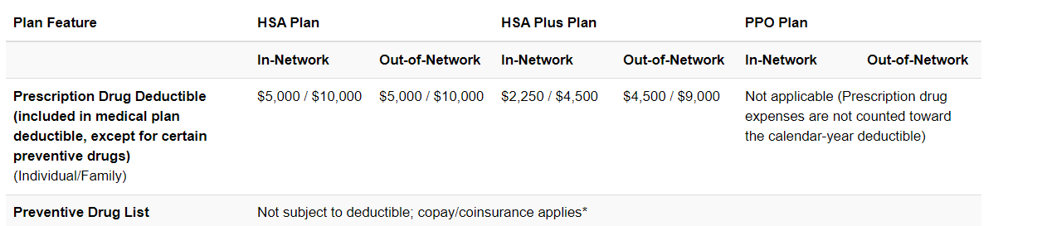
2025 Prescription Drug
*Copay/coinsurance for preventive drugs doesn’t count toward your deductible but is applied toward your annual out-of-pocket maximum. Preventive drugs per the Affordable Care Act are $0. All other preventive drugs under section 223(c)(2) of the Internal Revenue Code have the listed copays and coinsurance with minimums and maximums.

Slide 17
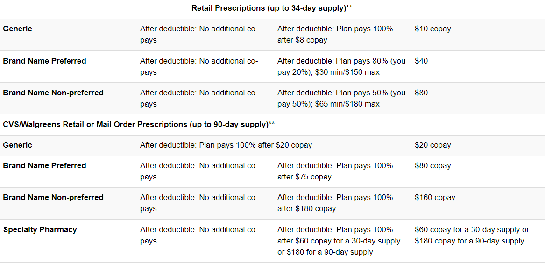
2025 Prescription Drug - Continued
**If the actual cost of the prescription is less than the copay or minimum dollar amount, you pay the actual cost.
***Specialty is only available at Accredo Specialty pharmacy.

Slide 18
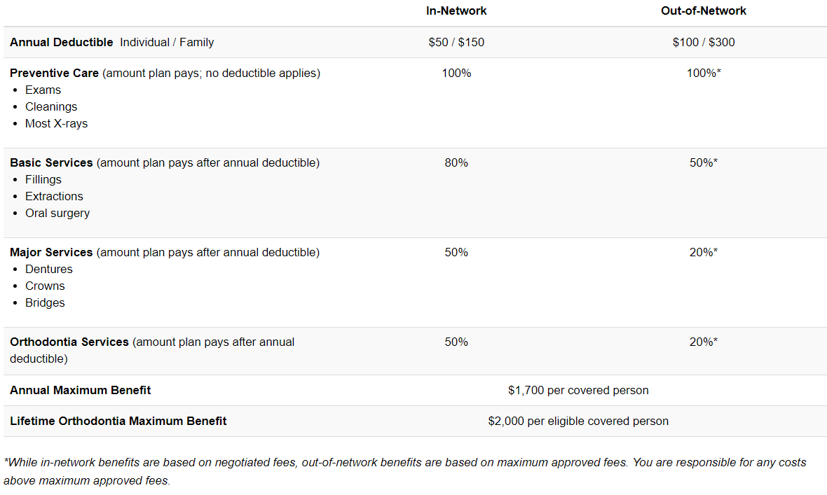
2025 Dental Plan

Slide 19
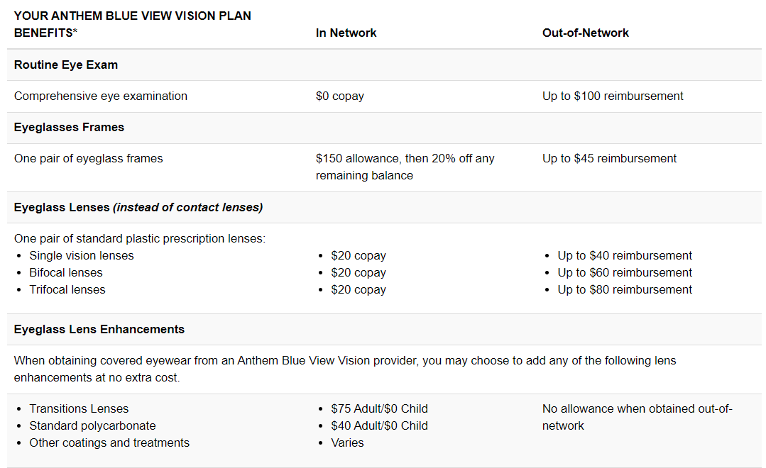
2025 Vision Plan
  Vision coverage is included automatically with your medical plan. All plan benefits available once per plan year.

Slide 20
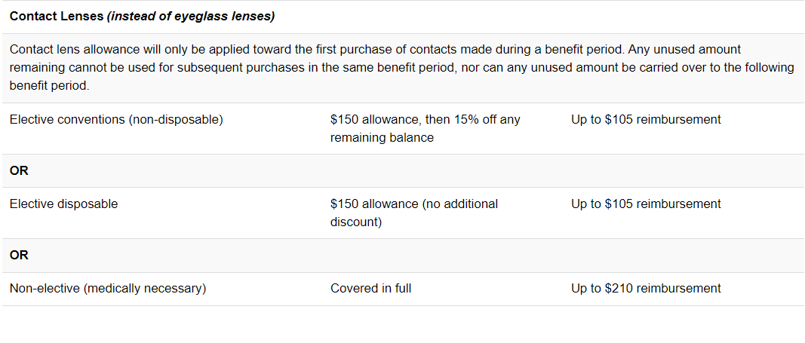
2025 Vision Plan - Continued

Slide 21
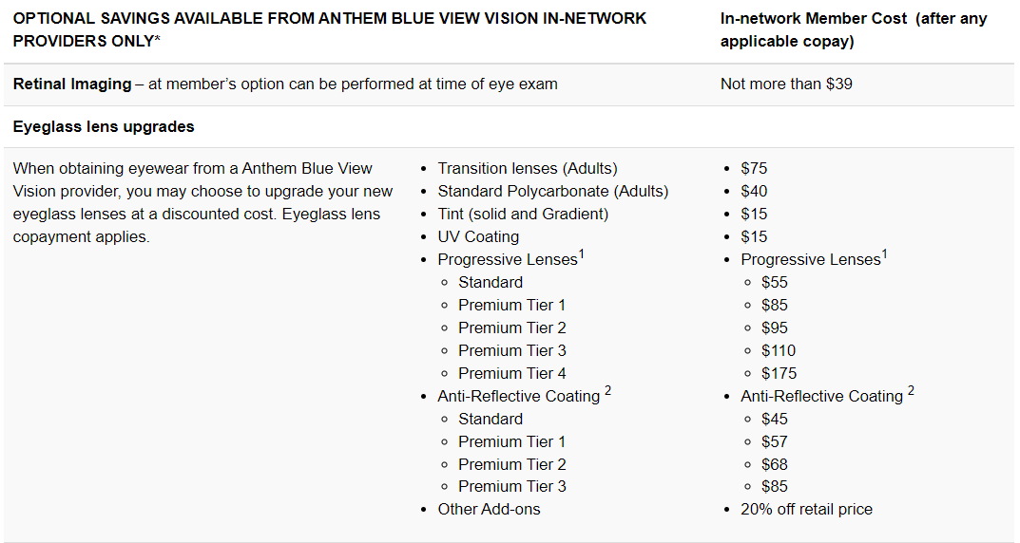
2025 Vision Plan - Additional Savings
¹ Please ask your provider for his/her recommendation as well as the available progressive brands by tier.
² Please ask your provider for his/her recommendation as well as the available coating brands by tier.

Slide 22
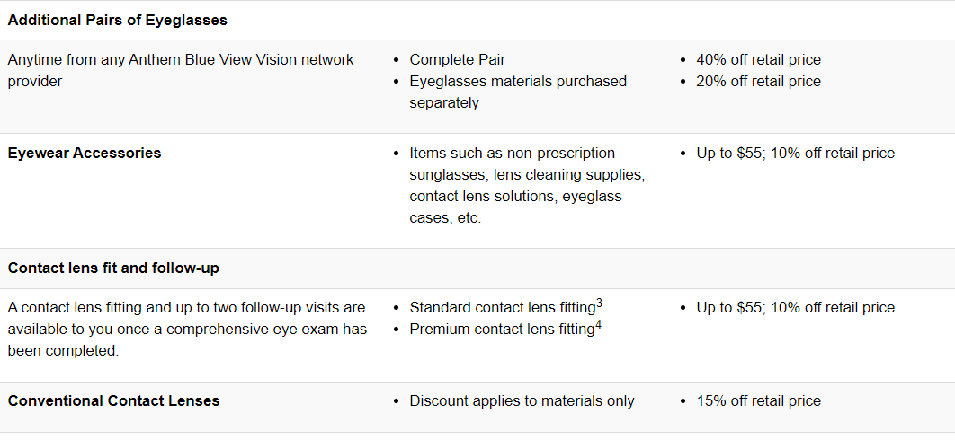
2025 Vision Plan - Additional Savings Cont’d
³ Standard fitting includes spherical clear lenses for conventional wear and planned replacement. Examples include but are not limited to disposable and frequent replacement.
⁴ Premium fitting includes all lens designs, materials and specialty fittings other than standard contact lenses. Examples include but are not limited to toric and multifocal.

Slide 23




2025 Open Enrollment
Employee Communication Overview
Home Mailers
MyTotalRewards
Overview Sessions
Enrollment
Heads-Up Postcard Brief intro of what to expect and how to prepare for Open Enrollment. Mail on 9/3
Get Ready to Enroll Guide explaining the benefits offered for 2025. Includes a QR code to the MyTotalRewards OE page. Mail on 9/16
Enrollment Reminder Postcards Mail on 10/14 and 10/28
Confirmation Statements Summary of elected 2025 benefits and covered dependents. Early December
In-Person Roadshow Sessions H&W representatives on-site at select Cummins locations to provide employees an overview of 2025 plan options and answer questions. Beginning 9/23
Virtual Zoom Sessions Live Zoom sessions for employees (and their families) overviewing benefit options for 2025. Morning, afternoon and evening sessions will be offered. Beginning 10/8
Pre-recorded Overview Recorded overview of benefit options for 2025
Enrollment window is Oct. 25 - Nov. 8. Employees will elect their 2025 benefits online using the CHB enrollment tool or over the phones by calling 1-877-377-4357. Important! With updated medical choices, encourage employees to review and enroll in the plan that best fits their needs for 2025.
Preview OE Content Page Summary of 2025 benefit choices, reminders of important dates, registration links for virtual overview sessions and details on the new Precision tool Live on 9/3
OE Content Page Additional content added to OE page including premium contributions rates, “employee like you” examples, and videos. Live on 9/18

Slide 24
Don’t Miss The Deadline!
October 25th through November 8th!
You’ll use the Cummins Health Benefits Service Center to make your enrollment elections. The system will guide you through a seamless process as you select your benefits and complete related steps.
If you need help making elections or choosing coverage, call the Service Center at 1-877-377-4357. With more representatives, you’ll receive quick service for your enrollment needs.
To ensure you have the coverage to meet your needs in 2025, take an active role and choose your benefits by Nov. 8.
In December, you’ll receive a confirmation of benefits statement in the mail summarizing your 2025 elections.
IMPORTANT: Review the statement carefully and make sure you are showing the covered dependents and plan elections you selected. If you find your selections are incorrect or you want to make changes, please reach out to the OCU Board immediately!!!! 812-377-6981
Remember, Health Savings Accounts (HSA) and Flexible Savings Account (FSA) contributions do not carry over. Both health and dependent care FSAs require an active election each year.

Slide 25

The End

